Slide 1
LAB 2 - Report
VARUN AGGARWAL

Slide 2
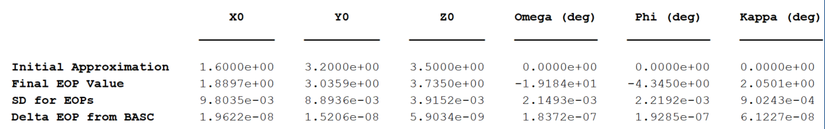
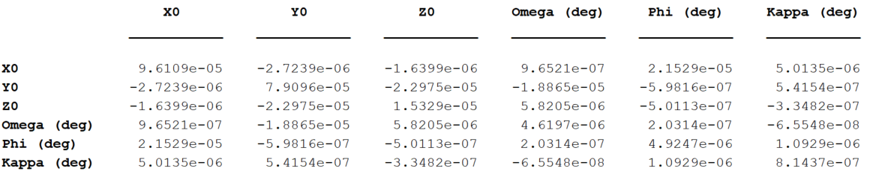
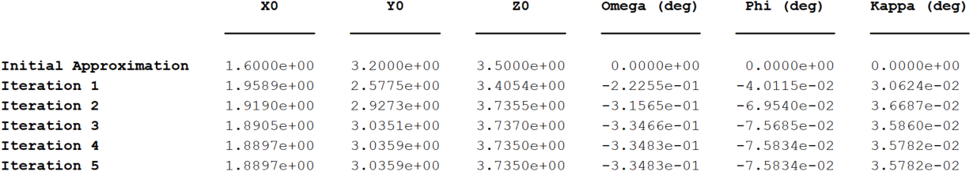
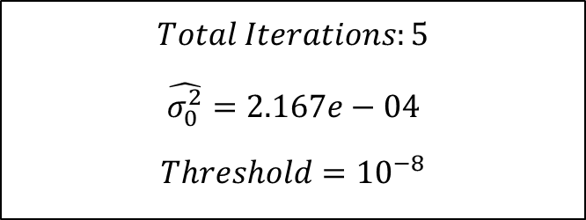
IMAGE 09
$$Total Iterations:5$$
$$\hat{σ_{0}^{2}}=2.167e−04$$
$$Threshold={10}^{−8}$$
Summary
Dispersion Matrix
EOPs over iterations

Slide 3
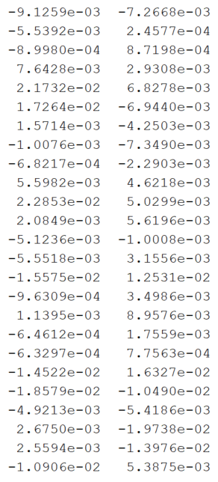
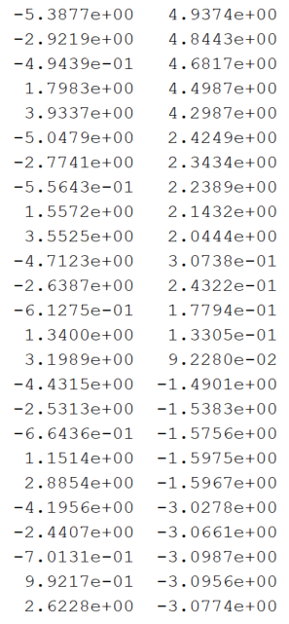




IMAGE 09
Residuals
Measured Image Co-ordinates (mm)
$$X$$
$$Y$$
$$x_{a}$$
$$y_{a}$$

Slide 4
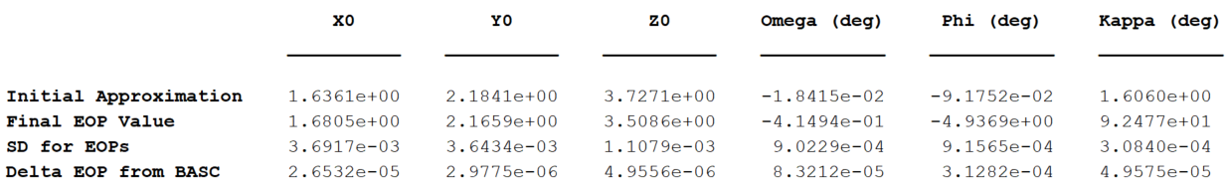
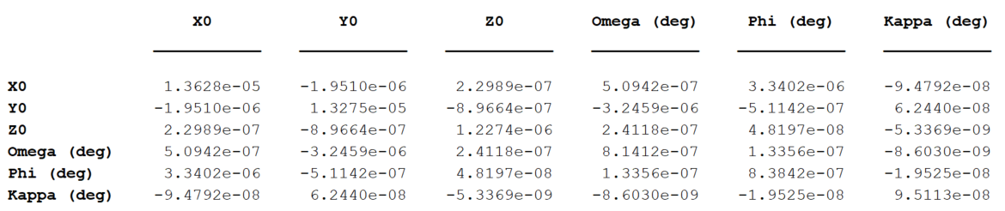
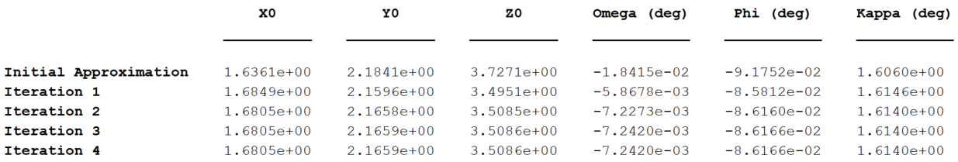
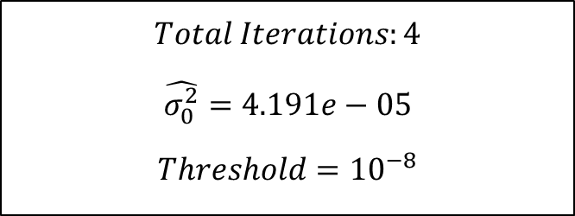
IMAGE 10
$$Total Iterations:4$$
$$\hat{σ_{0}^{2}}=4.191e−05$$
$$Threshold={10}^{−8}$$
Summary
Dispersion Matrix
EOPs over iterations

Slide 5
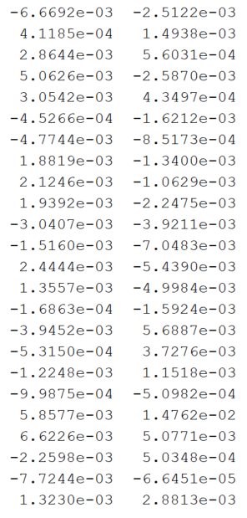
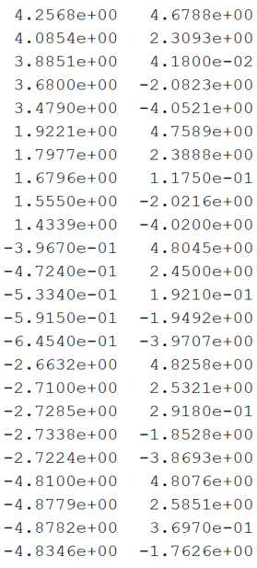
IMAGE 10
Residuals
Measured Image Co-ordinates (mm)
$$X$$
$$Y$$
$$x_{a}$$
$$y_{a}$$

Slide 6
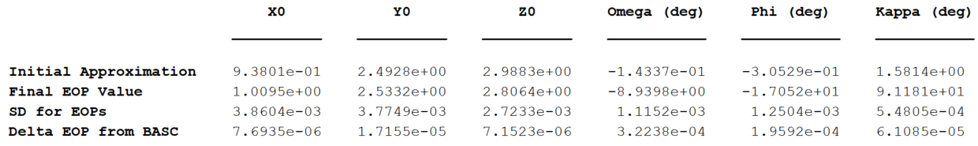
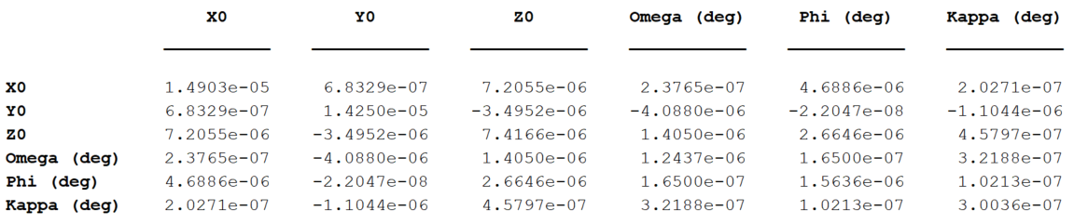
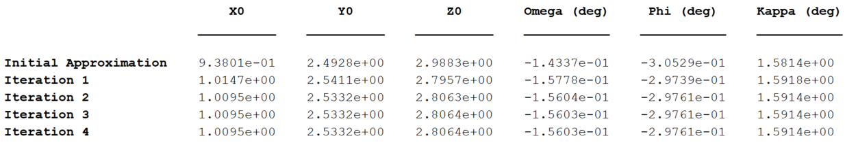
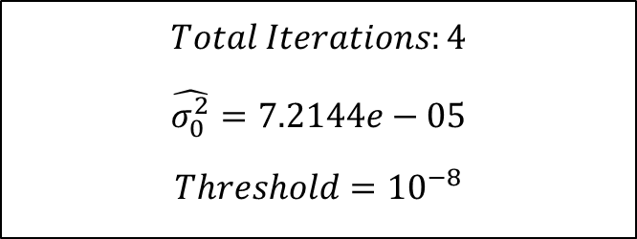
IMAGE 14
$$Total Iterations:4$$
$$\hat{σ_{0}^{2}}=7.2144e−05$$
$$Threshold={10}^{−8}$$
Summary
Dispersion Matrix
EOPs over iterations

Slide 7
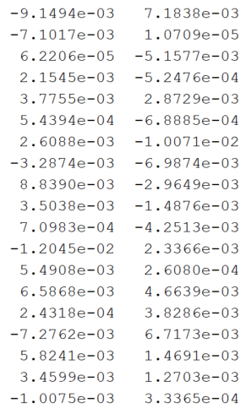
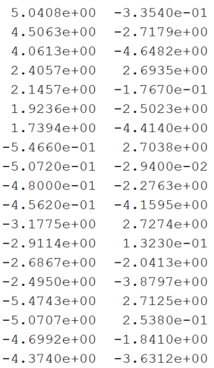
IMAGE 14
Residuals
Measured Image Co-ordinates (mm)
$$X$$
$$Y$$
$$x_{a}$$
$$y_{a}$$

Slide 8
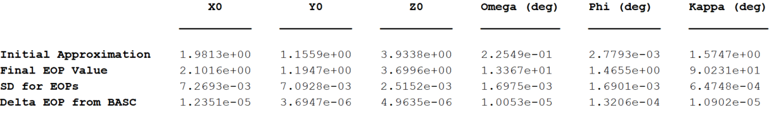
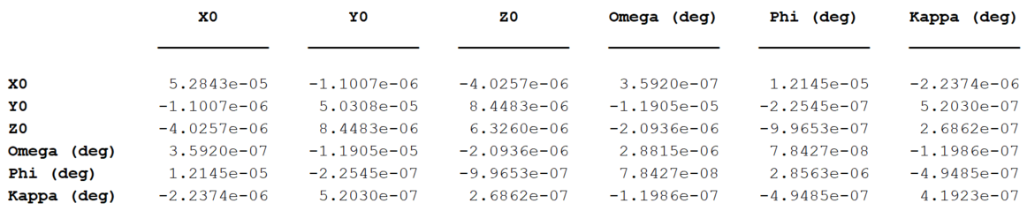
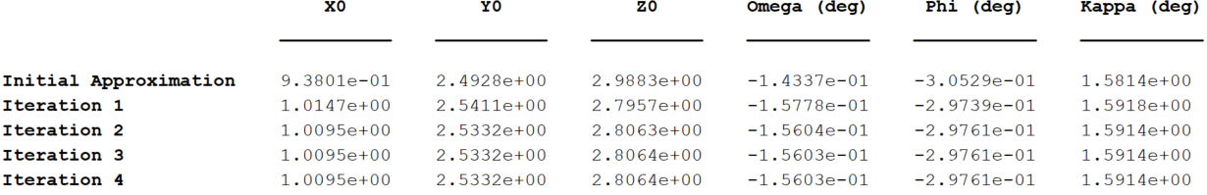
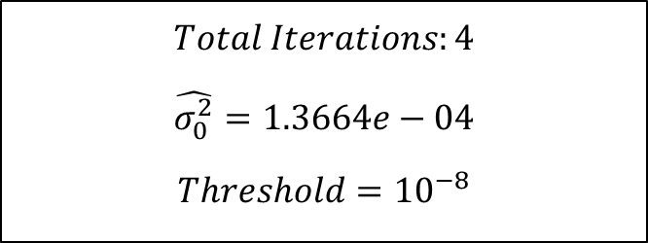
IMAGE 18
$$Total Iterations:4$$
$$\hat{σ_{0}^{2}}=1.3664e−04$$
$$Threshold={10}^{−8}$$
Summary
Dispersion Matrix
EOPs over iterations

Slide 9
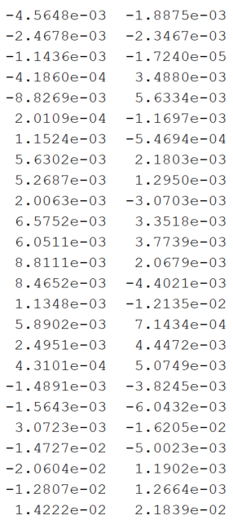
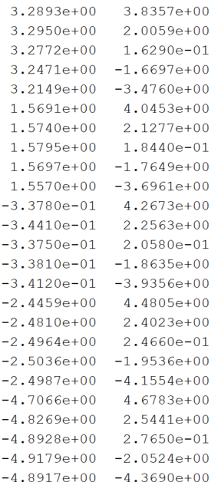
IMAGE 18
Residuals
Measured Image Co-ordinates (mm)
$$X$$
$$Y$$
$$x_{a}$$
$$y_{a}$$

Slide 10
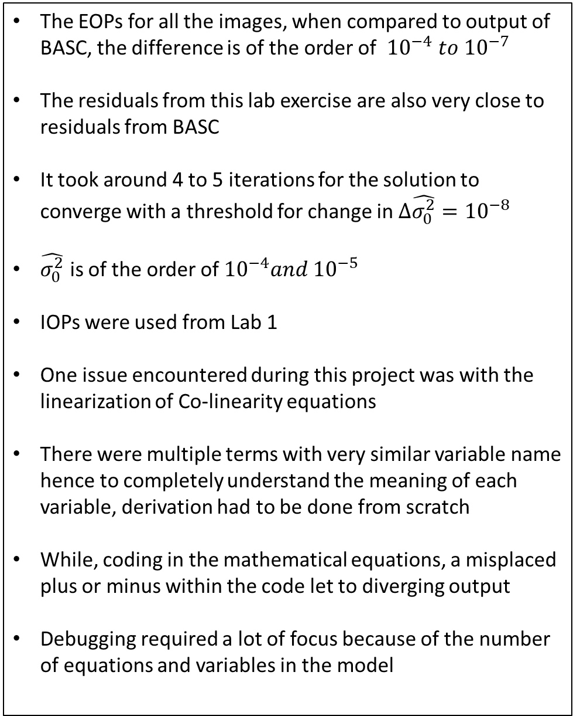
Issues and Explanation
The EOPs for all the images, when compared to output of BASC, the difference is of the order of ${10}^{−4} to {10}^{−7}$
The residuals from this lab exercise are also very close to residuals from BASC
It took around 4 to 5 iterations for the solution to converge with a threshold for change in ${Δ\hat{σ_{0}^{2}}=10}^{−8}$
$\hat{σ_{0}^{2}}$ is of the order of ${10}^{−4}and {10}^{−5}$
IOPs were used from Lab 1
One issue encountered during this project was with the linearization of Co-linearity equations
There were multiple terms with very similar variable name hence to completely understand the meaning of each variable, derivation had to be done from scratch
While, coding in the mathematical equations, a misplaced plus or minus within the code let to diverging output
Debugging required a lot of focus because of the number of equations and variables in the model

Slide 11
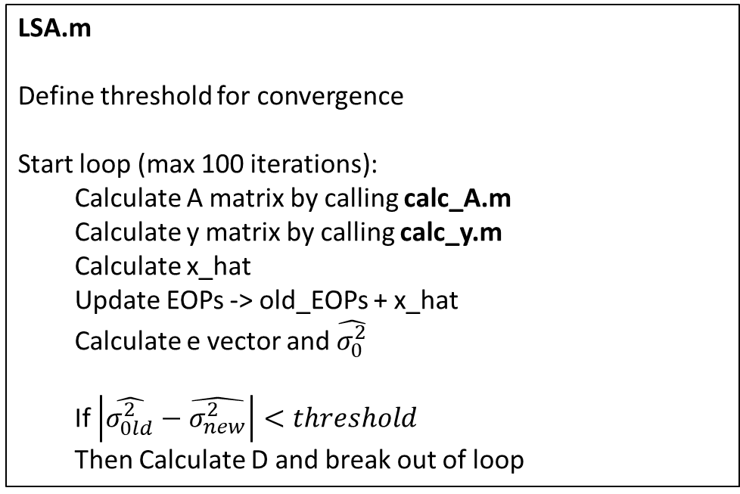
Computer Pseudo Code
main.m
Declare common parameters -> IOPs, Ground co-ordinates of targets
For each image:
Get image co-ordinates for each image
Call LSA.m function
Generate various results by calling results.m function
LSA.m
Define threshold for convergence
Start loop (max 100 iterations):
Calculate A matrix by calling calc_A.m
Calculate y matrix by calling calc_y.m
Calculate x_hat
Update EOPs -> old_EOPs + x_hat
Calculate e vector and $\hat{σ_{0}^{2}}$
If $\left|\hat{σ_{0ld}^{2}}−\hat{σ_{new}^{2}}\right|<threshold$
Then Calculate D and break out of loop

Slide 12
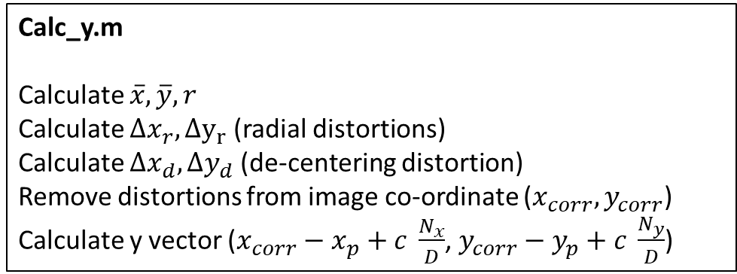
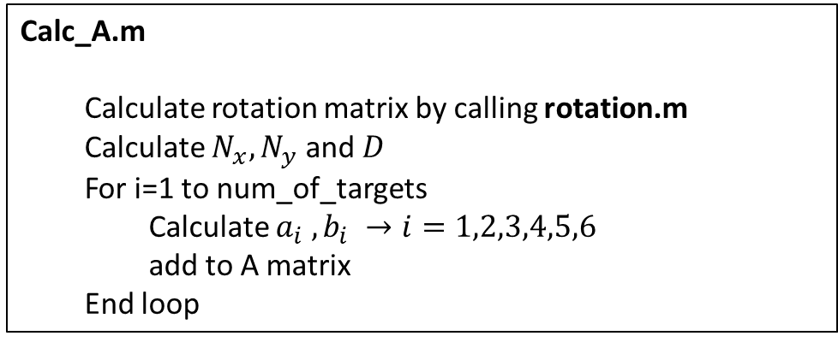
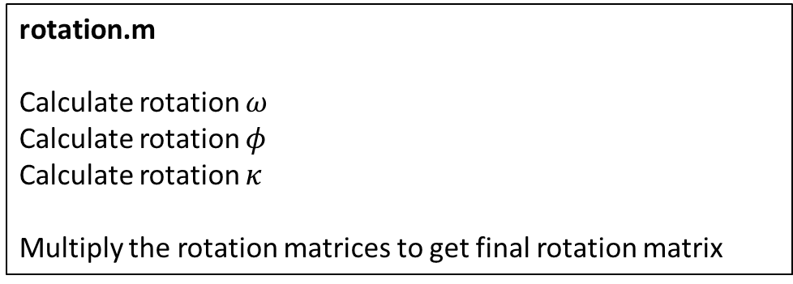
Computer Pseudo Code
Calc_A.m
Calculate rotation matrix by calling rotation.m
Calculate $N_{x}, N_{y}$ and $D$
For i=1 to num_of_targets
Calculate $a_{i} , b_{i} →i=1,2,3,4,5,6$
add to A matrix
End loop
Calc_y.m
Calculate $\overline{x},\overline{y},r$
Calculate $Δx_{r},Δy_{r}$ (radial distortions)
Calculate $Δx_{d},Δy_{d}$ (de-centering distortion)
Remove distortions from image co-ordinate ($x_{corr},y_{corr}$)
Calculate y vector ($x_{corr}−x_{p}+c \frac{N_{x}}{D}$, $y_{corr}−y_{p}+c \frac{N_{y}}{D}$)
rotation.m
Calculate rotation $ω$
Calculate rotation $φ$
Calculate rotation $κ$
Multiply the rotation matrices to get final rotation matrix
Code on Github:
https://github.com/Salazar-Prime/photogrammetry/tree/master/Project%202

Slide 13
Compute Code – main.py
%% Common Parameters
% IOPs
IOP = [6.7451660984e-2,-1.1709829919e-1,8.1671200690];
dist = [-2.9350008918e-4, 9.2190322166e-6,-2.2562559450e-7,6.1878890685e-5,-7.2907688047e-5,0];
% Ground co-ordinates of targets
XA = [-0.044038221723;0.89829592555;1.8428648416;2.7928032424;3.731135328;-0.036927916146;0.90108606018;1.8511589932;2.8010339963;3.7422959221;-0.037704361429;0.90892725171;1.8588605461;2.8062554595;3.7520655984;-0.024722332105;0.91454137562;1.8596674595;2.8078118825;3.7544680979;0;0.9263914178;1.8642980884;2.8111736654;3.7628755375];
YA = [3.751130948;3.7594793917;3.7736433303;3.7823238561;3.7801397656;2.8057675589;2.8180218203;2.8257925207;2.8332144474;2.8378518827;1.8634346772;1.8678901457;1.8758730363;1.8838128654;1.8922797004;0.91840024749;0.92066047041;0.92760553219;0.93553829291;0.94557055946;0;-0.00026178267339;-0.0021390199929;-0.0019752230297;0];
ZA = [0.072640804133;0.048121990404;0;-0.047649472361;-0.070838477818;0.054102199693;0.026008316122;0.0059282538012;-0.023295585379;-0.044574905144;0.016369939657;0.010208246675;0.0071618170061;-0.0096698096332;-0.020910207448;-0.0091692255168;0.003877584251;0.003049069041;-0.0030509411619;-0.0098127723745;0;0.017342094476;0.016047411487;0.006582607018;0];
%% Image 1 - image_09
[EOP_i,EOP_basc,xa,ya] = data(9); % get data for image 9
[EOP_9,e_9,sigma_hat_9,iter_9,D_9,EOP_history_9] = LSA(xa,ya,XA,YA,ZA,IOP,dist,EOP_i); % run LSA
[table_9_summary,table_9_D,table_9_hist] = results(EOP_i,EOP_9,D_9,EOP_basc,EOP_history_9,iter_9); % complie results
%% Image 1 - image_10
[EOP_i,EOP_basc,xa,ya] = data(10); % get data for image 10
[EOP_10,e_10,sigma_hat_10,iter_10,D_10,EOP_history_10] = LSA(xa,ya,XA(1:24),YA(1:24),ZA(1:24),IOP,dist,EOP_i); % run LSA
[table_10_summary,table_10_D,table_10_hist] = results(EOP_i,EOP_10,D_10,EOP_basc,EOP_history_10,iter_10); % complie results
%% Image 1 - image_14
[EOP_i,EOP_basc,xa,ya] = data(14); % get data for image 14
[EOP_14,e_14,sigma_hat_14,iter_14,D_14,EOP_history_14] = LSA(xa,ya,XA([3:5,7:10,12:15,17:20,22:25]),YA([3:5,7:10,12:15,17:20,22:25]),ZA([3:5,7:10,12:15,17:20,22:25]),IOP,dist,EOP_i); % run LSA
[table_14_summary,table_14_D,table_14_hist] = results(EOP_i,EOP_14,D_14,EOP_basc,EOP_history_14,iter_14); % complie results
%% Image 1 - image_18
[EOP_i,EOP_basc,xa,ya] = data(18); % get data for image 14
[EOP_18,e_18,sigma_hat_18,iter_18,D_18,EOP_history_18] = LSA(xa,ya,XA,YA,ZA,IOP,dist,EOP_i); % run LSA
[table_18_summary,table_18_D,table_18_hist] = results(EOP_i,EOP_18,D_18,EOP_basc,EOP_history_14,iter_14); % complie results
Code on Github:
https://github.com/Salazar-Prime/photogrammetry/tree/master/Project%202

Slide 14
Compute Code – LSA.py
function [EOP,e,sigma_hat,iter,D,EOP_history] = LSA(xa,ya,XA,YA,ZA,IOP,dist,EOP)
%% parameters
max_iter = 10000;
thres = 1e-8;
sigma_hat = 0;
num_GCP = length(xa);
% Unpack EOPs and IOPs
[X0,Y0,Z0,omega,phi,kappa] = update_EOP(EOP, zeros(6,1));
[xp,yp,c] = assign_IOP(IOP);
EOP_history = EOP;
%% LSA iterations
for iter=1:max_iter
% update sigma_hat_prev
sigma_hat_prev = sigma_hat;
% OAX, OAY, OAZ
OAX = XA - X0;
OAY = YA - Y0;
OAZ = ZA - Z0;
% calculate A_50x6 (num_GCP,c,OAX,OAY,OAZ,omega,phi,kappa)
[A,Nx,Ny,D] = calc_A(num_GCP, c, OAX, OAY, OAZ, omega, phi, kappa);
% calculate y_50x1 (dist,xa,ya,xp,yp,c,Nx_mat,Ny_mat,D_mat)
y = calc_y(dist,xa,ya,xp,yp,c,Nx,Ny,D);
% calculate x_hat
P = eye(num_GCP*2);
x_hat = inv(A'*P*A)*A'*P*y;
% update EOPs
[X0,Y0,Z0,omega,phi,kappa,EOP] = update_EOP(EOP, x_hat);
EOP_history = [EOP_history;EOP]
% calculate e and sigma_hat
e = y - A*x_hat;
sigma_hat = (e'*P*e)/(num_GCP - length(x_hat));
% break out of loop is threshold is reached
if abs(sigma_hat - sigma_hat_prev) < thres
D = sigma_hat*inv(A'*P*A);
e = [e(1:2:end),e(2:2:end)];
EOP = [X0,Y0,Z0,rad2deg(omega),rad2deg(phi),rad2deg(kappa)];
break
end
end
Code on Github:
https://github.com/Salazar-Prime/photogrammetry/tree/master/Project%202

Slide 15
Compute Code – calc_A.py
function [A,Nx_mat,Ny_mat,D_mat] = calc_A(num_GCP,c,OAX,OAY,OAZ,omega,phi,kappa)
%% calculate rotation
r = rotation(omega,phi,kappa);
%% calculate N and D (OAX,OAY,OAZ,rot)
Nx_mat = r(1,1)*OAX + r(2,1)*OAY + r(3,1)*OAZ;
Ny_mat = r(1,2)*OAX + r(2,2)*OAY + r(3,2)*OAZ;
D_mat = r(1,3)*OAX + r(2,3)*OAY + r(3,3)*OAZ;
%% calculate aij, bij
% create an empty A matrix
A = zeros(num_GCP*2,6);
% loop over all ground control points
for i=1:num_GCP
% Nx, Ny, D for ith target
Nx = Nx_mat(i);
Ny = Ny_mat(i);
D = D_mat(i);
% aij for ith GCP
a1 = r(1,1)*D - r(1,3)*Nx;
a2 = r(2,1)*D - r(2,3)*Nx;
a3 = r(3,1)*D - r(3,3)*Nx;
a4 = D*(r(3,1)*OAY(i) - r(2,1)*OAZ(i)) + Nx*(r(2,3)*OAZ(i) - r(3,3)*OAY(i));
a5 = D*D*cos(kappa) - Nx*(-Nx*cos(kappa) + Ny*sin(kappa));
a6 = -1 * Ny*D;
% bij for ith GCP
b1 = r(1,2)*D - r(1,3)*Ny;
b2 = r(2,2)*D - r(2,3)*Ny;
b3 = r(3,2)*D - r(3,3)*Ny;
b4 = D*(r(3,2)*OAY(i) - r(2,2)*OAZ(i)) + Ny*(r(2,3)*OAZ(i) - r(3,3)*OAY(i));
b5 = -1*D*D*sin(kappa) - Ny*(-Nx*cos(kappa) + Ny*sin(kappa));
b6 = Nx*D;
% multiplying by c/D^2 before appending into A
A(2*i-1,:) = [a1,a2,a3,a4,a5,a6]*c/D^2;
A(2*i,:) = [b1,b2,b3,b4,b5,b6]*c/D^2;
end
Code on Github:
https://github.com/Salazar-Prime/photogrammetry/tree/master/Project%202

Slide 16
Compute Code – calc_y.py
function [y] = calc_y(dist,xa,ya,xp,yp,c,Nx,Ny,D)
%% calculate x_corr and y_corr
% unpack distortion parameters
k1 = dist(1);
k2 = dist(2);
k3 = dist(3);
p1 = dist(4);
p2 = dist(5);
p3 = dist(6);
% calculate x_bar, y_bar, r
x_bar = xa - xp;
y_bar = ya - yp;
r = sqrt(x_bar.^2 + y_bar.^2);
% calculate delta_xr, delta_yr - radial distortion
delta_xr = x_bar .* (k1*r.^2 + k2*r.^4 + k3*r.^6);
delta_yr = y_bar .* (k1*r.^2 + k2*r.^4 + k3*r.^6);
% calculate delta_xd, delta_yd - de-centering lens distortion
delta_xd = (1+p3*r.^2).*(p1*(r.^2 + 2*x_bar.^2) + 2*p2*x_bar.*y_bar);
delta_yd = (1+p3*r.^2).*(2*p1*x_bar.*y_bar + p2*(r.^2 + 2*y_bar.^2));
% cremove distortions
x_corr = xa - delta_xr - delta_xd;
y_corr = ya - delta_yr - delta_yd;
%% calcualte y
x_corr = x_corr - (xp - c*Nx./D);
y_corr = y_corr - (yp - c*Ny./D);
% alternate merge in order : x_corr and y_corr
y = [x_corr y_corr]';
y = y(:);
end
Code on Github:
https://github.com/Salazar-Prime/photogrammetry/tree/master/Project%202

Slide 17
Compute Code – rotation.py
function [rot]=rotation(omega, phi, kappa)
rot_o = [1 0 0; 0 cos(omega) -sin(omega); 0 sin(omega) cos(omega)];
rot_p = [cos(phi) 0 sin(phi); 0 1 0; -sin(phi) 0 cos(phi)];
rot_k = [cos(kappa) -sin(kappa) 0; sin(kappa) cos(kappa) 0; 0 0 1];
rot = rot_o * rot_p * rot_k;
end
Compute Code – update_EOP.py
function [X0,Y0,Z0,omega,phi,kappa,EOP]=update_EOP(EOP, x_hat)
X0 = EOP(1) + x_hat(1);
Y0 = EOP(2) + x_hat(2);
Z0 = EOP(3) + x_hat(3);
omega = EOP(4) + x_hat(4);
phi = EOP(5) + x_hat(5);
kappa = EOP(6) + x_hat(6);
EOP = [X0,Y0,Z0,omega,phi,kappa];
end
Code on Github:
https://github.com/Salazar-Prime/photogrammetry/tree/master/Project%202

Slide 18
Compute Code – results.py
function [summary,D,hist,e]=results(EOP_i, EOP_f, D, EOP_basc, hist, iter)
out = [EOP_i;EOP_f;transpose(diag(D).^0.5);abs(EOP_basc - EOP_f)];
row=["Initial Approximation"];
for i=1:iter
row=[row,sprintf("Iteration %d",i)];
end
summary = array2table(out,'VariableNames',["X0","Y0","Z0","Omega (deg)","Phi (deg)","Kappa (deg)"],'RowNames',["Initial Approximation","Final EOP Value","SD for EOPs","Delta EOP from BASC"]);
D = array2table(D,'VariableNames',["X0","Y0","Z0","Omega (deg)","Phi (deg)","Kappa (deg)"],'RowNames',["X0","Y0","Z0","Omega (deg)","Phi (deg)","Kappa (deg)"]);
hist = array2table(hist,'VariableNames',["X0","Y0","Z0","Omega (deg)","Phi (deg)","Kappa (deg)"],'RowNames',row);
end
Compute Code – assign_IOP.py
function [xp,yp,c]=assign_IOP(IOP)
xp = IOP(1);
yp = IOP(2);
c = IOP(3);
end
Code on Github:
https://github.com/Salazar-Prime/photogrammetry/tree/master/Project%202

Slide 19
Compute Code – data.py
function [EOP_i,EOP_basc,xa,ya]=data(image_no)
switch image_no
case 9
EOP_i = [1.60,3.20,3.5,0,0,0];
EOP_basc = [1.88968674,3.03586621,3.73500036,-19.1841784,-4.34497759,2.05014903];
xa = [-5.3877;-2.92187;-0.49439;1.79834;3.93369;-5.04787;-2.77407;-0.55643;1.5572;3.55246;-4.71235;-2.63868;-0.61275;1.34004;3.19895;-4.43154;-2.5313;-0.66436;1.1514;2.88537;-4.19557;-2.4407;-0.70131;0.99217;2.62277];
ya = [4.93742;4.84433;4.68172;4.49867;4.29866;2.42494;2.3434;2.23887;2.1432;2.04441;0.30738;0.24322;0.17794;0.13305;0.09228;-1.49013;-1.53833;-1.5756;-1.59753;-1.59671;-3.02777;-3.06606;-3.09871;-3.09563;-3.07743];
case 10
EOP_i = [1.636114 2.184056 3.727135 deg2rad(-1.055093) deg2rad(-5.256979) deg2rad(92.014892)];
EOP_basc = [1.68045678e+000 2.16587520e+000 3.50855335e+000 -4.14855263e-001 -4.93725230e+000 9.24769326e+001];
xa = [4.2568;4.0854;3.8851;3.68;3.479;1.9221;1.7977;1.6796;1.555;1.4339;-0.3967;-0.4724;-0.5334;-0.5915;-0.6454;-2.6632;-2.71;-2.7285;-2.7338;-2.7224;-4.81;-4.8779;-4.8782;-4.8346];
ya= [4.6788;2.3093;0.0418;-2.0823;-4.0521;4.7589;2.3888;0.1175;-2.0216;-4.02;4.8045;2.45;0.1921;-1.9492;-3.9707;4.8258;2.5321;0.2918;-1.8528;-3.8693;4.8076;2.5851;0.3697;-1.7626];
case 14
EOP_i = [0.938012 2.492823 2.988345 deg2rad(-8.214459) deg2rad(-17.492066) deg2rad(90.607889)];
EOP_basc = [1.00952899e+000 2.53318361e+000 2.80635782e+000 -8.94008150e+000 -1.70515538e+001 9.11810993e+001];
xa = [5.0408;4.5063;4.0613;2.4057;2.1457;1.9236;1.7394;-0.5466;-0.5072;-0.48;-0.4562;-3.1775;-2.9114;-2.6867;-2.495;-5.4743;-5.0707;-4.6992;-4.374];
ya = [-0.3354;-2.7179;-4.6482;2.6935;-0.1767;-2.5023;-4.414;2.7038;-0.0294;-2.2763;-4.1595;2.7274;0.1323;-2.0413;-3.8797;2.7125;0.2538;-1.841;-3.6312];
case 18
EOP_i = [1.981303 1.155948 3.933779 deg2rad(12.919527) deg2rad(0.159243) deg2rad(90.221535)];
EOP_basc = [2.10162316e+000 1.19465520e+000 3.69958966e+000 1.33667830e+001 1.46559054e+000 9.02308070e+001];
xa = [3.2893;3.295;3.2772;3.2471;3.2149;1.5691;1.574;1.5795;1.5697;1.557;-0.3378;-0.3441;-0.3375;-0.3381;-0.3412;-2.4459;-2.481;-2.4964;-2.5036;-2.4987;-4.7066;-4.8269;-4.8928;-4.9179;-4.8917];
ya = [3.8357;2.0059;0.1629;-1.6697;-3.476;4.0453;2.1277;0.1844;-1.7649;-3.6961;4.2673;2.2563;0.2058;-1.8635;-3.9356;4.4805;2.4023;0.2466;-1.9536;-4.1554;4.6783;2.5441;0.2765;-2.0524;-4.369];
end
end

